Slide 1
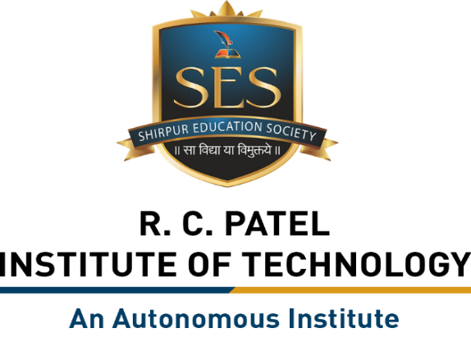
Semester Project – I
“Customer Churn Prediction System”
By
Dhiraj Sunil Mahajan (251108029 & AD026)
Mohit Shankar Zope (251108083 & AD069)
Hemant Sandip Fegade (251108090 & AD075)
Mayur Arun Mahajan (251108097 & AD081)
Under the Guidance of
Prof. Sandip S. Hire
Department of Artificial Intelligence and Data Science
The Shirpur Education Society’s
R. C. Patel Institute of Technology, Shirpur - 425405.
[2026-27]

Slide 2
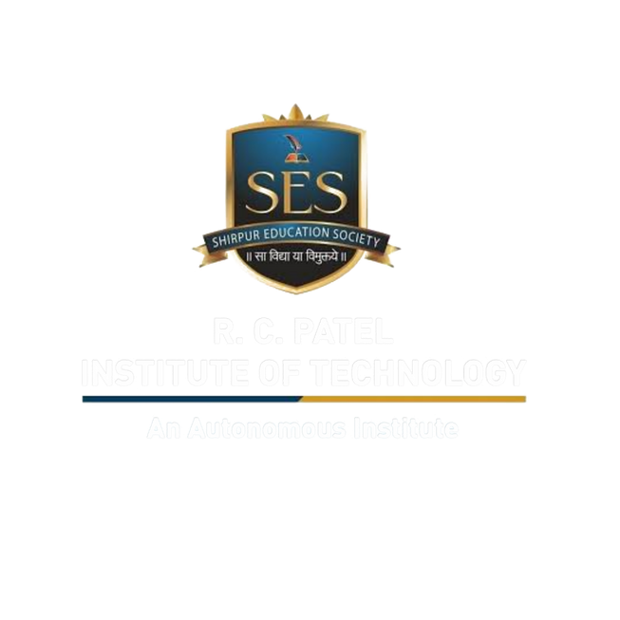
Outline
Project Title & Team Introduction
Outline
Domain Overview
Problem Statement
Literature Survey
Comparative Analysis
Proposed Methodology
Software Requirements
Hardware Requirements
10. Timeline / Gantt Chart
11. Dataset & Data Collection
12. Data Preprocessing
13. Exploratory Data Analysis (EDA)
14. Future Scope
15. Conclusion
16. Reference

Slide 3
Domain Overview
Domain: Data Science & Machine Learning
Telecommunication companies generate large amounts of customer data such as recharge history, call usage, internet usage, plan details, complaints and customer tenure.
Customer Churn Prediction uses this historical data to identify customers who are likely to stop using a SIM service.

Slide 4
Why this domain?
Domain Overview
Telecom companies face high customer competition.
Losing existing customers affects revenue.
Predicting churn allows companies to take preventive action.
Machine Learning can identify hidden patterns in customer behavior.

Slide 5
Problem Statement
Current Problem
Telecom companies cannot easily identify which SIM users may leave their network.
Customers may switch due to high prices, poor network quality, limited offers, or bad service.
Losing customers causes revenue loss and increases the cost of getting new customers
Proposed Solution
Develop a Customer Churn Prediction System using customer data.
The system analyzes factors such as usage, recharge history, complaints, and service plans.
It predicts customers who are likely to leave.
The company can then provide better offers, discounts, or improved services to retain them.

Slide 6
Literature Survey
Study/Approach | Dataset/Domain | Method | Main Finding
Telecom churn studies | Telecom customers | Logistic Regression | Customer behavior can predict churn
ML-based churn prediction | Telecom dataset | Decision Tree | Important customer features can be identified
Ensemble-based prediction | Telecom | Random Forest | Improved prediction performance
Customer behavior analysis | Telecom | Classification models | Usage and service factors influence churn

Slide 7
Comparative Analysis
Feature | Traditional System | Proposed System
Customer analysis | Manual/limited | Automated
Churn prediction | After customer leaves | Before customer leaves
Data analysis | Basic | ML-based
Risk identification | Limited | Low/Medium/High
Customer behavior | Basic analysis | Multiple features
Visualization | Limited | Dashboard
Decision support | Low | High
Scalability | Limited | Better

Slide 8
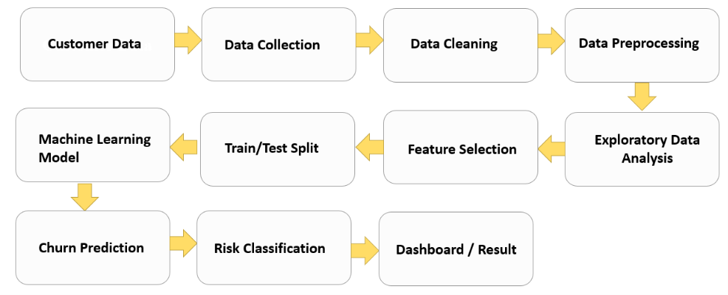
Proposed Methodology

Slide 9
Software Requirements
Requirement | Technology
Programming | Python
Data Processing | Pandas, NumPy
Visualization | Matplotlib, Seaborn
Machine Learning | Scikit-learn
Database | MySQL
Backend | Flask
Frontend | HTML, CSS, JavaScript
Development | VS Code / Jupyter Notebook
Dataset | CSV / Telecom Dataset

Slide 10
Hardware Requirements
Laptop/Desktop
Minimum 4 GB RAM
Recommended 8 GB+ RAM
Intel i3/Ryzen 3 or better
Minimum 10 GB free storage
Internet connection for development/research

Slide 11
Timeline / Gantt Chart
✓
Activity
W1
17/08/26 to
22/08/26
W2
23/08/26 to
28/08/26
W3
30/08/26 to
5/09/26
W4
6/09/26 to
12/09/26
W5
W6
W7
W8
Problem Identification
✓
Literature Survey
✓
✓
Requirement Analysis
✓
Dataset Collection
✓
✓
✓
✓
✓
Data Preprocessing
✓
EDA
✓
✓
Model Development
Backend Development
Frontend / Dashboard
Testing
Final Documentation
12/09/2026
8

Slide 12
Dataset & Data Collection
What is a Dataset ?
Data Collection
A dataset is a collection of related information used for analysis.
It contains rows representing customers and columns representing features.
In our project, the data represents SIM/telecom customers.
The dataset contains customer details, service information and billing behavior.
The Churn column is the target variable.
Customer Information: Age, gender & location.
Service & Plan: SIM type, plan & charges.
Usage Behavior: Data, calls & SMS usage.
Billing & Payment: Bills, recharges & payments.
Customer Tenure: SIM usage duration.

Slide 13
Data Preprocessing
Main Steps
What is Data Preprocessing?
Data Cleaning – Remove errors and duplicate records
Missing Values – Handle incomplete data
Data Transformation – Convert data into suitable formats
Encoding – Convert categorical values into numerical values
Feature Selection – Select relevant features
Data Splitting – Divide data into training and testing sets
Data preprocessing is the process of cleaning and transforming raw data before using it for machine learning.
Why is it Needed?
Clean and properly prepared data helps the ML model produce better predictions.

Slide 14
Exploratory Data Analysis (EDA)
EDA in Our Project
What is EDA?
Analyze Churn vs Non-Churn customers
Study the relationship between Tenure and Churn
Compare Monthly Charges and Churn
Analyze Contract Type and Churn
Identify important churn-related features
EDA is the process of examining and visualizing data to understand patterns, trends and relationships.

Slide 15
Future Scope
Real-time customer prediction
SMS/email retention offers
Mobile application
Advanced ML/deep learning models
Automatic customer segmentation
Explainable AI
Real-time telecom database integration
Personalized offers based on customer behavior

Slide 16
Conclusion
Uses customer usage and behavioral data to predict churn.
Applies Machine Learning models to analyze historical customer data.
Classifies customers based on their churn probability.
Identifies potentially dissatisfied customers.
Helps telecom companies take preventive retention actions.

Slide 17
References APA format
IBM. (n.d.). Customer churn analytics. IBM. https://www.ibm.com/
Kaggle. (n.d.). Telco customer churn dataset. Kaggle. https://www.kaggle.com/
Pedregosa, F., Varoquaux, G., Gramfort, A., Michel, V., Thirion, B., Grisel, O., Blondel, M., Prettenhofer, P., Weiss, R., Dubourg, V., Vanderplas, J., Passos, A., Cournapeau, D., Brucher, M., Perrot, M., & Duchesnay, É. (2011). Scikit-learn: Machine learning in Python. Journal of Machine Learning Research, 12, 2825–2830.
Python Software Foundation. (n.d.). Python 3 documentation. https://docs.python.org/3/
The pandas development team. (n.d.). panda documentation. https://pandas.pydata.org/docs/
NumPy Developers. (n.d.). NumPy documentation. https://numpy.org/doc/
Verbeke, W., Martens, D., Mues, C., & Baesens, B. (2011). Building comprehensible customer churn prediction models with advanced rule induction techniques. Expert Systems with Applications, 38(3), 2354–2364.
Han, J., Kamber, M., & Pei, J. (2012). Data mining: Concepts and techniques (3rd ed.). Morgan Kaufmann.

Slide 18

Questions & Answers
18

